Slide 1
International study centre
An Introduction to object-orientation and the java programming language:
Control Structures
Name : John Alamina
Email : john.alamina@hud.ac.uk

Slide 2
Outline
Types of Control Structure
Sequential Control
Expression types
Selection Control
Unconditional-if
Conditional-if
Bi-conditional if
Cascaded-if
Nested-if
Switch-statements
Iteration Control
Types of loops
While
do-while
for-loop
Nested-Loops
Arrays
Exercises

Slide 3
Types of control Structures
Sequential
Selection (branch)
Iteration (loop)

Slide 4
Sequential Statements
Commands
Declaration e.g: int x;
Assignment e.g. int x=45;
Expressions e.g. z= x+y;

Slide 5
Any Questions?

Slide 6
Selection (Branch) control
Control structures that are not sequential in nature by default will contain a condition statement.
That is, execution will follow two or more different paths.
Any condition that all paths never lead to previously executed statements is a selection.
However, if any path returns back to a previously executed statement those set of statements are in a loop control.

Slide 7
Selection types
Unconditional if
Conditional-if
Bi-conditional if
Cascaded-if
Nested-if
Switch statement

Slide 8
Unconditional-if
Unconditional if
Conditional-if
Bi-conditional if
Cascaded-if
Nested-if
Switch statement

Slide 9
Conditional-if
Unconditional if
Conditional-if
Bi-conditional if
Cascaded-if
Nested-if
Switch statement

Slide 10
Bi-Conditional-if
Unconditional if
Conditional-if
Bi-conditional if
Cascaded-if
Nested-if
Switch statement

Slide 11
Cascaded-if
Unconditional if
Conditional-if
Bi-conditional if
Cascaded-if
Nested-if
Switch statement

Slide 12
Nested-if
Unconditional if
Conditional-if
Bi-conditional if
Cascaded-if
Nested-if
Switch statement

Slide 13
Switch-statements
Types of Control Structure
Sequential Control
Expression types
Selection Control
Unconditional-if
Conditional-if
Bi-conditional if
Cascaded-if
Nested-if
Switch-statements
Iteration Control
Types of loops
While
do-while
for-loop
Nested-Loops
Arrays
Exercises

Slide 14
Iteration (Loop) control
Types of Control Structure
Sequential Control
Expression types
Selection Control
Unconditional-if
Conditional-if
Bi-conditional if
Cascaded-if
Nested-if
Switch-statements
Iteration Control
Types of loops
While
do-while
for-loop
Nested-Loops
Arrays
Exercises

Slide 15
Iteration (Loop) control
Types of Control Structure
Sequential Control
Expression types
Selection Control
Unconditional-if
Conditional-if
Bi-conditional if
Cascaded-if
Nested-if
Switch-statements
Iteration Control
Types of loops
While
do-while
for-loop
Nested-Loops
Arrays
Exercises

Slide 16
Iteration (Loop) control
Types of Control Structure
Sequential Control
Expression types
Selection Control
Unconditional-if
Conditional-if
Bi-conditional if
Cascaded-if
Nested-if
Switch-statements
Iteration Control
Types of loops
While
do-while
for-loop
Nested-Loops
Arrays
Exercises

Slide 17
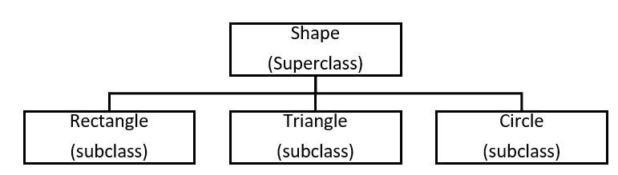
Terms Used in Object-oriented Design.
Object – A person, place, thing, event, concept, screen or report.
Class – A template from which objects are created, it is a software abstraction of a group of objects with common properties (Attributes), behaviour (operations).
Subclass – If class “B” inherits from class “A”, class “B” is a subclass of “A” and “A” is a superclass of “B”.
Abstract class – A class that does not have objects created from it.
Association – Relationship between objects.

Slide 18
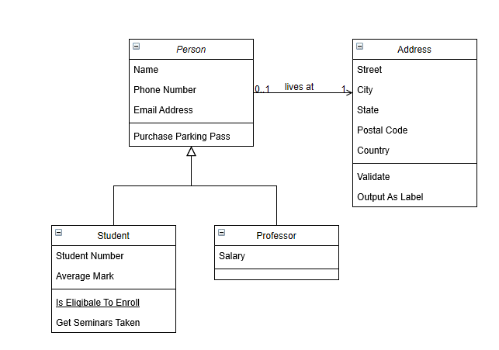
Unified Modeling Language (UML).
Go to www.draw.io >> choose “save diagrams to device” >> click “create new diagram” >> select “Class Diagram”.
The following example should be shown on your screen:

Slide 19
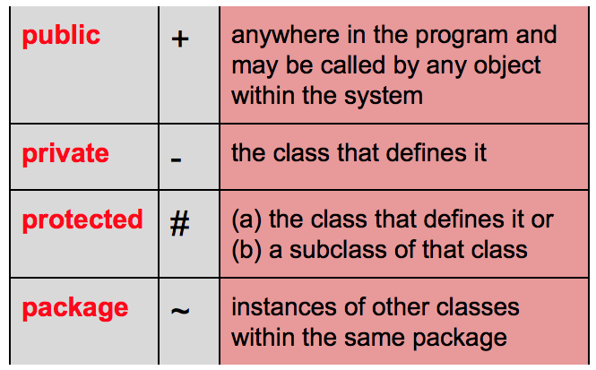
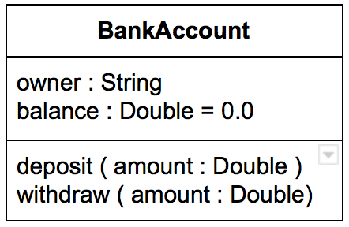
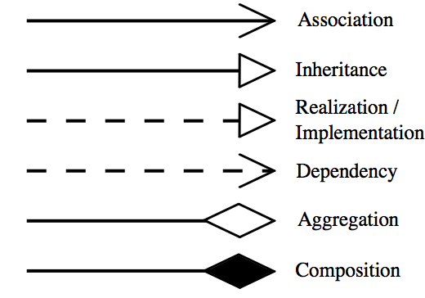
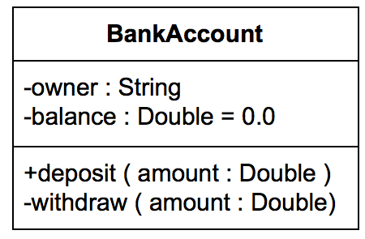
Representations in UML.
Visibility of class members
Class Representation
Class name
Class attributes
Class methods
Relationships

Slide 20
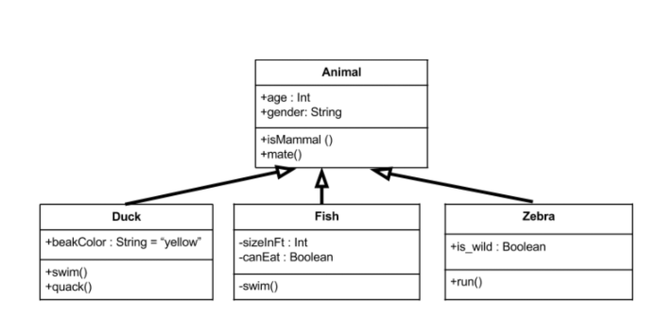
Class Diagram – Example.
Animal is the super class. Duck, Fish, and Zebra are subclasses and they inherit all the members from the superclass. The subclasses also have their own attributes and methods.

Slide 21
Drawing of Basic Class Diagram - Exercise
Create a class diagram representing the transport options available for moving from Manchester to London using draw draw.io.
It should include a superclass whose fields can be inherited by other classes.
Create three subclasses representing the means of transportation with their own unique fields in addition to those inherited from the superclass.
Ensure that class name, attributes, methods, visibility and relationship are covered in your diagram.
Final model should be submitted on Brightspace.

Slide 22
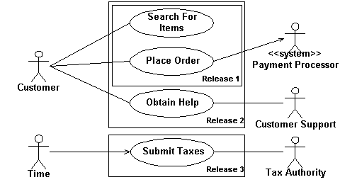
Use Case Diagrams
A UML use-case diagram is used to provide an overview of all or part of the usage requirements in the form of a model.
It shows the relationship among actors and use cases within a system.
An actor is a person, organization, local processes ( e.g. system clock), or external system that plays a role in one or more interactions with your system.
Actors are drawn as stick figures

Slide 23
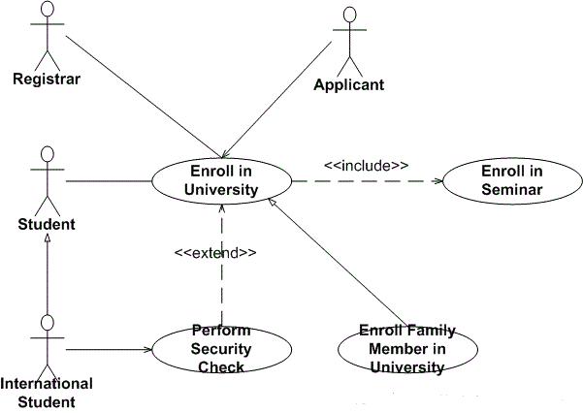
Use Case Diagrams – Relationship Guidelines
Solid lines are used when an actor supplies or receives information or initiates the use case
Used case description is represented in an oval.
Include is used to attach a smaller use case to a base use case, this makes them more manageable.
Extend is used when an optional use case is needed under certain conditions.
Include and extend are represented with dashed arrows.

Slide 24
Use Case Diagram – Exercise
Create a use case diagram on www.draw.io that represents students and teacher’s interaction with the Software Design Module Brightspace Page.
It should show the actors.
Think of a minimum of four use cases that involves at least one of the actors and include these in your diagram.
Think of one use case that involves two of the actors and represent this as well.

